Slide 1





RECOMMENDER SYSTEMS
Batuhan TALŞIK
OREDATA

Slide 2






What is Recommendation System ?
The system that predict user's preference or rating.

Slide 3
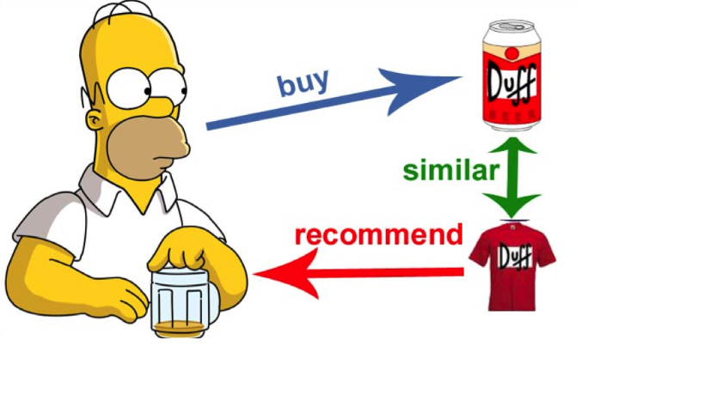
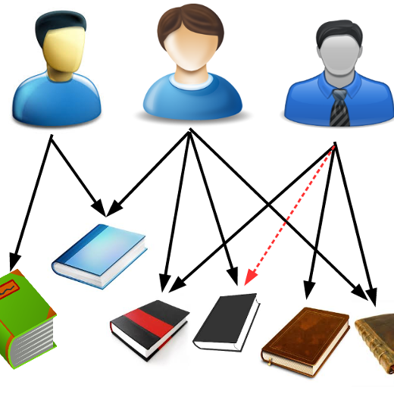
Types Of Recommender Systems
Content Based Recommender Systems
Collaborative Filtering
- Similarity Metrics
- User Based Colllaborative Filtering
- Item Based Collaborative Filtering
Apriori

Slide 4



Content Based Recommender Sytems
Content based recommender systems focus on item's content without any user's ratings.
Example:
- Metallica, Iron Maiden and Megadeth are heavy metal bands and someone who listen Metallica probably also listen Iron Maiden or Megadeth. You can recommend this bands to user who listen Metallica. This is all about content based recommendation.

Slide 5
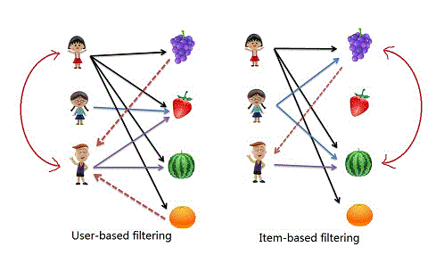
Collaborative Filtering
User Based Collaborative Filtering: Recommend an item based on the ratings of similar users found.
Item Based Collaborative Filtering: Recommend an item based on the information of similar items computed.

Slide 6
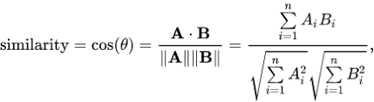
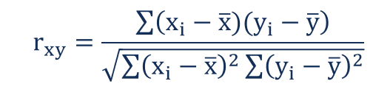
Similarity Metrics

Slide 7
User Based Collaborative Filtering Example
 | The Dark Knight | Iron Man 3 | Harry Potter – Prisoner of Azkaban | Star Wars – Return of the Jedi | The Lord of the Rings –Two Towers
John | 4 | 3 | 2 | 4 | 5
Mary | 5 | 4 | 3 | 3 | 4
Alice | 3 | 2 | 5 | 2 | 3
Sim(John,Mary)=(5x4)+…+(4*5)/sqrt(4^2+…+5^2)*sqrt(5^2+…+4^2) = 0.96
Sim(John,Alice)=(4x3)+…+(5*3)/sqrt(4^2+…+5^2)*sqrt(3^2+…+3^2) = 0.85
Sim(Mary,Alice)=(5x3)+…+(4*3)/sqrt(5^2+…+4^2)*sqrt(3^2+…+3^2) = 0.90
We can recommend movies which liked by John to Mary.( Most similar )

Slide 8
Item Based Collaborative Filtering Example
 | John | Mary | Alice
The Dark Knight | 4 | 5 | 3
Iron Man 3 | 3 | 4 | 2
Harry Potter - Prisoner of Azkaban | 2 | 3 | 5
Star Wars - Return of the Jedi | 4 | 3 | 2
The Lord of the Rings – Two Towers | 5 | 4 | 3
Recommended Movies for The Dark Knight
Iron Man 3
The Lord of the Rings – Two Towers
Star Wars – Return of the Jedi
Harry Potter – Prisoner of Azkaban
Sim(The Dark Knight, Iron Man 3):
(4*3)+(5*4)+(3*2)/sqrt(4^2+5^2+3^2)*sqrt(3^2+4^2+2^2) = 0.99
Sim(The Dark Knight,Harry Potter – Prisoner of Azkaban):
(4*2)+(5*3)+(3*5)/sqrt(4^2+5^2+3^2)*sqrt(2^2+3^2+5^2) = 0.87
Sim(The Dark Knight, Star Wars – Return of the Jedi):
(4*4)+(5*3)+(3*2)/sqrt(4^2+5^2+3^2)*sqrt(4^2+3^2+2^2) = 0.97
Sim(The Dark Knight, The Lord of the Rings – Two Towers):
(4*5)+(5*4)+(3*3)/sqrt(4^2+5^2+3^2)*sqrt(5^2+4^2+3^2) = 0.98

Slide 9
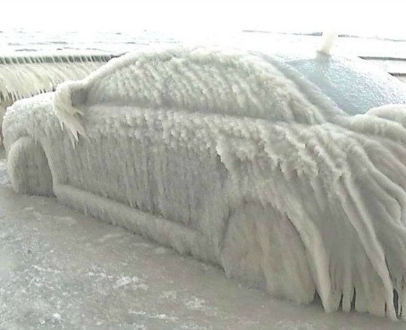
Cold Start Problem
A major challenge of the collaboratıve fıltering approach can be how to make recommendatıons for a new user,that ıs called cold-start problem.

Slide 10
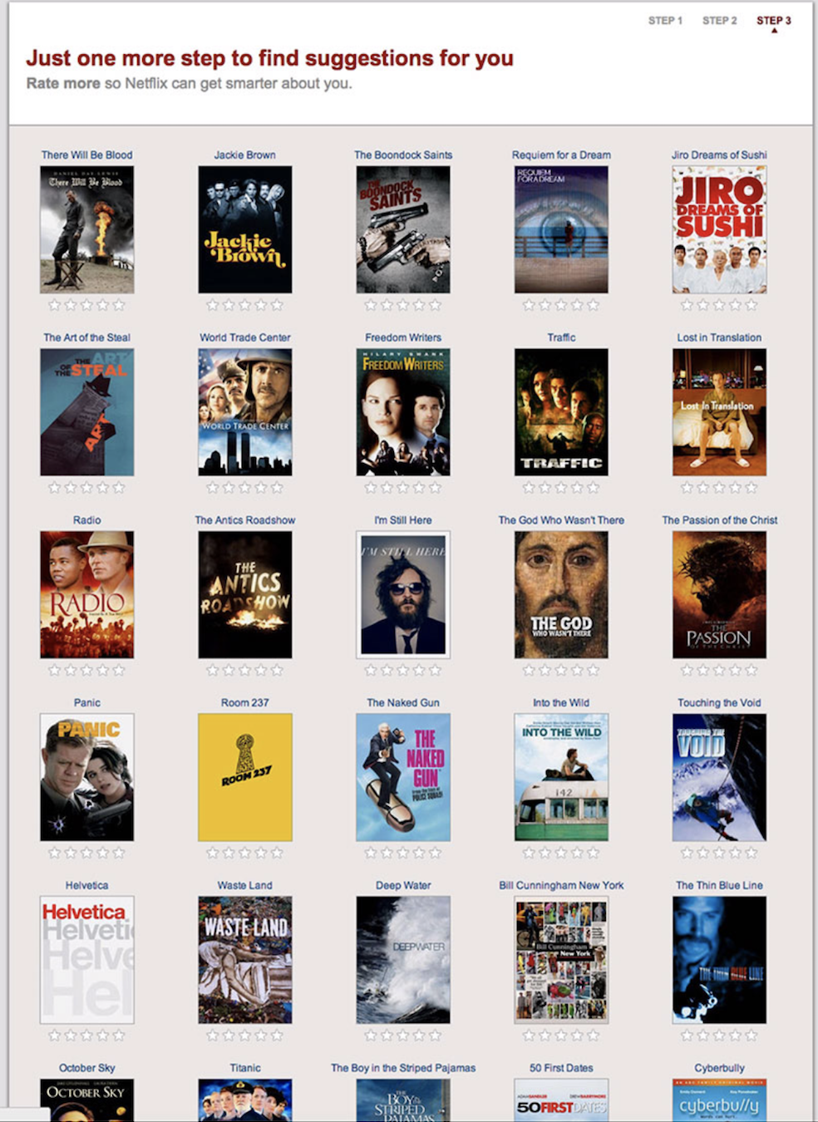
Ask-to-Rate
A cold start is really hard challenge for collaborative filtering. There are efficient methods based on ask-to-rate to handle this problem such as popularity strategy,entropy or clustering.

Slide 11
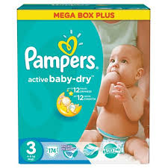
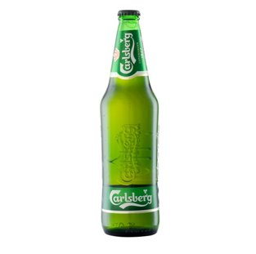
Apriori
People who bought also bought..

Slide 12
EXAMPLE
PRODUCTS
Burgers, French Fries, Cola
Burgers, French Fries, Mayonnaise
Vegetables, Fruits, Mayonnaise
Pasta, Fruits, Butter, Vegetables, Ketchup,Mayonnaise
Burgers, Ketchup, French Fries
Fruits, Orange Juice, Vegetables
Burgers, French Fries, Ketchup, Mayonnaise
Burgers
French Fries
RULES
Fruits
Vegetables
Burgers, French Fries
Ketchup

Slide 13

Apriori - Support
# transactions containing item
Support(Item) :
# transactions
Interest : Burgers
4
PRODUCTS
Burgers, French Fries, Cola
Burgers, French Fries, Mayonnaise
Vegetables, Fruits, Mayonnaise
Pasta, Fruits, Butter, Vegetables, Ketchup,Mayonnaise
Burgers, Ketchup, French Fries
Fruits, Orange Juice, Vegetables
Burgers, French Fries, Ketchup, Mayonnaise
Support(Burgers) :
=
0.5714
7
4
Support(French Fries) :
=
0.5714
7
3
Support(Ketchup) :
=
0.4285
7
4
Support(Mayonnaise) :
=
0.5714
7
1
Support(Cola) :
=
0.1428
Minimum Support: 0.25
7

Slide 14
Apriori - Confidence
# transactions containing Item1 and Item2
Confidence(Item1 - Item2 ) :
# transactions containing Item1
PRODUCTS
Burgers, French Fries, Cola
Burgers, French Fries, Mayonnaise
Vegetables, Fruits, Mayonnaise
Pasta, Fruits, Butter, Vegetables, Ketchup,Mayonnaise
Burgers, Ketchup, French Fries
Fruits, Orange Juice, Vegetables
Burgers, French Fries, Ketchup, Mayonnaise
4
Confidence(Burgers - French Fries) :
=
1
4
Confidence(Burgers - Mayonnaise) :
2
=
0.5
4
Confidence(Burgers - Ketchup) :
2
=
0.5
4
Minimum Confidence: 0.5

Slide 15
Apriori - Lift
Confidence(Item1 - Item2 ) :
Lift(Item1 - Item2 ) :
Support(Item2 ) :
PRODUCTS
Burgers, French Fries, Cola
Burgers, French Fries, Mayonnaise
Vegetables, Fruits, Mayonnaise
Pasta, Fruits, Butter, Vegetables, Ketchup,Mayonnaise
Burgers, Ketchup, French Fries
Fruits, Orange Juice, Vegetables
Burgers, French Fries, Ketchup, Mayonnaise
1
Lift(Burgers – French Fries ) :
=
1.75
0.5714
Lift(Burgers – Mayonnaise ) :
0.5
=
0.8750
0.5714
Lift(Burgers – Ketchup ) :
0.5
=
1.16
0.4285
RULES
Burgers
1.75
French Fries
Burgers
1.16
Ketchup
Burgers
0.8750
Mayonnaise

Slide 16
What if we interest burgers and french fries ?
PRODUCTS
Burgers, French Fries, Cola
Burgers, French Fries, Mayonnaise
Vegetables, Fruits, Mayonnaise
Pasta, Fruits, Butter, Vegetables, Ketchup,Mayonnaise
Burgers, Ketchup, French Fries
Fruits, Orange Juice, Vegetables
Burgers, French Fries, Ketchup, Mayonnaise
Support(Burgers, French Fries) :
4
=
0.5714
7
4
Support(Mayonnaise) :
=
0.5714
7
3
Support(Ketchup) :
=
0.4285
7
Support(Cola) :
1
0.1428
=
7
2
0.5
0.5
Confidence(Burgers,French Fries-Mayonnaise) :
=
Lift(Burgers,French Fries - Mayonnaise ) :
=
0.8750
4
0.5714
2
0.5
0.5
Confidence(Burgers,French Fries-Ketchup) :
=
Lift(Burgers,French Fries - Ketchup ) :
=
1.16
4
0.4285
RULES
Burgers,French Fries
1.16
Ketchup
Burgers,French Fries
0.8750
Mayonnaise

Slide 17
References:
Item-Based Collaborative Filtering Recommendation Algorithms,Badrul Sarwar, George Karypis, Joseph Konstan, and John Riedl
Cold-start Problem in Collaborative Recommender Systems: Efficient Methods Based on Ask-to-rate Technique, Mohammad-Hossein Nadimi-Shahraki and Mozhde Bahadorpour
superdatascience.com

Slide 18


batuhan-talsik

